Slide 1



BARANGAY FLOOD REPORT AND CLOGGED DRAINAGE
TRACKING SYSTEM
Presented by Group 4

Slide 2
OBJECTIVES
GENERAL OBJECTIVES
To develop a C++ program that emulates the flood report and clogged drainage tracking process of a barangay using appropriate data structures and algorithms.

Slide 3
OBJECTIVES
SPECIFIC OBJECTIVES
1. RECORD - Manage incoming reports using a queue, served first come, first served
2. SEARCH- Find reports by report ID using binary search and by street name using linear search
3. SORT - Sort reports by severity and organize them by status (pending or fixed) using merge sort
4. ANALYZE - Analyze the time complexity of enqueue, dequeue, search and sort using Big-O and measured runtime

Slide 4
PROBLEM BACKGROUND
TYPHOON DATA IS HARD TO READ
  The Philippines frequently experiences typhoons.
  Weather and flood data are difficult to analyze.
  Lack of clear data makes preparation difficult.

Slide 5
PROBLEM BACKGROUND
FLOOD AND DRAINAGE REPORTS ARE HARD TO MANAGE
  Scattered reports.
  Lack of prioritization.
  Limited monitoring.

Slide 6
WHAT THE PROGRAM DOES
RECORD
Saves each report in a queue, first come, first served
FIND
Search by report ID (binary search) or street name (linear search)
PRIORITIZE
Sort by severity (merge sort), mark as fixed, and undo mistakes (stack)

Slide 7
SCOPE AND DELIMITATIONS
SCOPE
  Records flood and clogged drainage reports (report ID, street, flood level, date and time, status)
  Serves reports first come, first served using a queue
  Searches by report ID (binary search) and by street (linear search)
  Sorts reports by severity using merge sort

Slide 8
SCOPE AND DELIMITATIONS
DELIMITATIONS
  Console program in C++, with data saved in text files only
  One user only (a barangay staff member who types in the reports)
  No maps, GPS, weather data, crew assignment or notifications
  Does not predict floods or find their cause

Slide 9
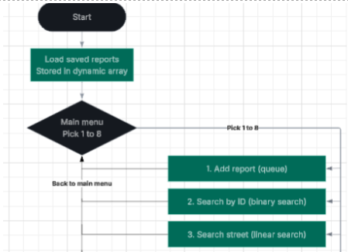
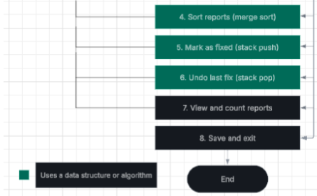
FLOWCHART

Slide 10





OUR TEAM
AGUIILA, aDANIEL
ACELAJADO, JOHN VINCE
DIEZ, ANGELA MAY
DUENAS, RALPH
IGLOSO, DENZEN

Slide 11
REFERENCES
  Apacible, L. M. (2026, August 8). Habagat floods parts of Metro Manila, roads remain passable.
  https://tribune.net.ph/2026/08/08/habagat-floods-parts-of-metro-manila-roads-remain-passable
  Binary search algorithm and time complexity explained. (n.d.). freeCodeCamp.
  https://www.freecodecamp.org/news/binary-search-algorithm-and-time-complexity-explained/
  Demaine, E., Ku, J., & Solomon, J. (2020). Lecture 3: Sorting [Lecture notes]. In 6.006 Introduction to algorithms.
  https://ocw.mit.edu/courses/6-006-introduction-to-algorithms-spring-2020/resources/mit6_006s20_lec3/

Slide 12
THANK
YOU

